Slide 1
Toxic Comment Classification
Supervisor : Eng Fady Maher

Slide 2
Team Members
Omer Hamada
Hend Abdel Nasser
Hesham Mostafa
Yara Yasser

Slide 3
What is the Project About?
This project focuses on detecting toxic comments automatically using:
Machine Learning
Natural Language Processing (NLP)
The system analyzes text comments and classifies them into harmful categories such as:
Toxic
Insult
Threat
Obscene language
Identity heat
The goal is to help create safer online communities.

Slide 4
Why is This Important?
PROBLEM
SOLUTION
Online platforms receive millions of comments daily. Some comments contain:
Hate
speech
Threats
Toxic language
Build an NLP-based multi-label classification system using machine learning.

Slide 5
Generic Pipeline
Data Acquisition
Text Cleaning
Preprocessing
Feature Engineering
Monitoring and Model Updating
Deployment
Evaluation
Modeling

Slide 6
1-Dataset Acquisiont
The dataset (Jigsaw Toxic Comment Classification Dataset) contains:
User comments
Multiple toxicity labels
Main classes:
Insult
Toxic
Severe Toxic
Threat
Obscene language
Identity heat

Slide 7
Dataset Distribution(Visualization)
43.6%
Toxic comments
4.5%
Severe Toxic
22.4%
Insults
24.2%
Obscene
1.4%
Threats
4%
Hate

Slide 8
2-Text Cleaning
Cleaning the Text Data
Converting
Performence
Text to lowercase
Compare model performance
Removing
Machine Learning
Predict toxicity
URLs Punctuation Special character
Build multiple machine learning models
Predict toxicity categories automatically

Slide 9
2-Text Cleaning
Purpose:
Reduce noise
Improve text quality
prepare comments for NLP processing

Slide 10
3- Pre-Processing
Preparing Text for Machine Learning
01
02
03
Tokenization
Lemmatization
Stopworsd Removal

Slide 11
4-Feature Engineering
Converting Text into Numerical Features
Machine learning models cannot understand raw text directly.
TF-IDF Vectorization :
Word frequency
Word importance across documents
Additional Features
Unigrams
Bigrams

Slide 12
5-Modeling
Machine Learning Models
Logistic Regression
Support Vector Machine(SVM)
AdaBoost
Decision Tree
Random Forest
Best Performing Model Linear SVM

Slide 13
6-Imbalanced Dataset Problem
Imbalanced Dataset Problem
Some toxicity classes were rare:
Treat
Identity Heat
Severe Toxic
Solution (Threshold Tuning 0.3)
Improves minority class detection
Increase Recall and FI-score
More suitable for NLP tasks than traditional oversampling
Improved toxic class detection performance

Slide 14
7-Evaluation
Model Performance Evaluation
01
Accuracy
Jigsaw Toxic Comment Dataset
02
Text Preprocessing
Cleaning and normalization
03
Feature Engineering
TF-IDF vectorization
04
Model Training
ML classifiers for toxicity prediction

Slide 15
Evaluation Accuracy
Additional Evaluation
TF-IDF vs BERT comparison
Model ranking based on F1-score
60%
90%
70%
30%
Accuracy
F1-score
Percision
Recall

Slide 16
8-Results
Model | Accuracy | F1-score
Logistic Regression
SVM
Decision Tree
Random Forest
AdaBoost
Good
Moderate
Best
Highest
Lower
Weak
Hifh
Weak
High
Weak

Slide 17
8-Results
Feature Method | Accuracy | F1-score
TF-IDF
BERT + SVM
0.91
0.57
0.90
0.53
SVM achieved the best balance between:
Precision
Recall

Slide 18
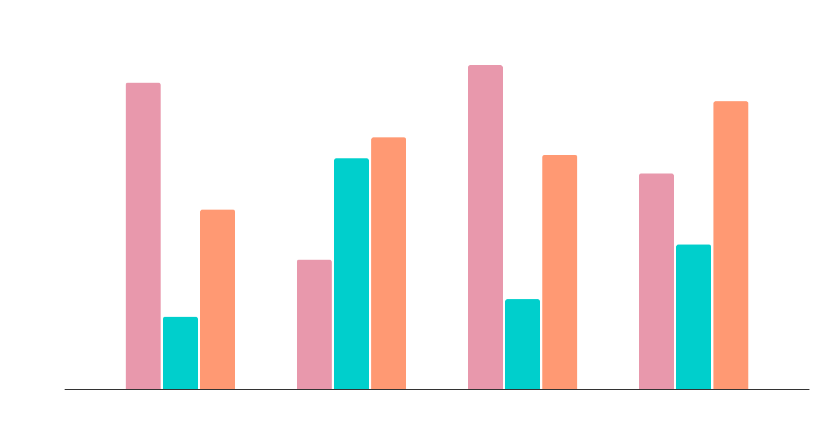
Performance Comparison
Accuracy
Precision
Recall

Slide 19
Workflow
STEP BY STEP
01
Step 1
Data preprocessing
Step 2
02
Feature extraction using TF-IDF
03
Step 3
Training and evaluation

Slide 20
Explainable AI (LLM Integration)
Purpose:
Generate human-readable explanations for toxicity predictions.
Groq API
Example
Comment :“ I will kill you ”
Prediction:
Toxic = 1
Threat = 1
Llama 3.1 Model
Benefits
Improves transparency
Makes predictions understandable
Enhances user trust

Slide 21
Technologies Used
ML models
Feature extraction
Scikit-learn
TF-IDF
Deployment
Python
NLTK
Gradio
Deployment
NLP preprocessing

Slide 22
9-Applications of the System
Social Media Moderation
Gaming Chat Protection
Online Forums
Educational Platforms

Slide 23
Advantages of the System
Fast Detection
Scalable
Intelligent
Automatically analyzes comments
Handles large datasets
Uses NLP techniques

Slide 24
Project Stages Timeline
01
Data Collection
02
EDA
03
Training & Evaluation

Slide 25
Project Analysis
S
STRENGTH
Large dataset, Real-world application, Multi-label classification
W
WEAKNESSES
Imbalanced data Large training time
O
OPPORTUNITIES
Social media moderation,
AI-powered safety systems
T
THREATS
False predictions,
Ambiguous language

Slide 26
Conclusion
This project successfully applied:
Natural Language Processing (NLP)
Machine Learning
Explainable AI
to automatically detect toxic online comments.
Key Achievements :
Cleaned and processed text data
Extracted meaningful features using TF-IDF
Compared multiple ML models
Improved minority class detection using Threshold Tuning
Built explainable toxicity prediction using LLMs
Deployed the system using Gradio
Achieved beat result using SVM

